Slide 1
Forest Resources Inventory
Tableau Dashboard with Databricks Tables as cloud‑based data source
Ian Sinclair (FRI), Peitao Xu (FRI)
Philip Liu (LRC), Alexia Tu (LRC)
May 08, 2026
Notes:
Today I’ll walk through how we’re delivering the FRI T2 Tableau dashboards, and why we’re moving toward using Databricks as a cloud‑based data source.
The focus is on reliability, performance, and long‑term scalability as we publish more FMUs and more LiDAR products.

Slide 2

FRI T2 LiDAR Data
Dashboard Overview
Ministry of Natural Resources | Science and Research Branch
Natural Resources Information Section (NRIS)
Forest Resources Inventory (FRI)
Ian Sinclair
Peitao Xu
March 09, 2026

Slide 3


Overview of the Term 2 (T2) inventory process
Checkpoint #1
Checkpoint #2
Checkpoint #3
T2 ABA inventory
Segmentation analysis
Age
review
FIM T2 validation
PCI
OPI
Standardized approach
Tool to combine layers
  Disturbance analysis
Species
review
T1 FIM validation
  Industry/FRI
  FII poly
  Update
T1/T2 Height review
PI
review
Draft T2 inventory
SFL Checkpoints
Pre-inventory
intake discussion
LiDAR/remote sensing modelling
validation results
Draft inventory review
SFL: Sustainable Forest Licensee
FIM: Forest Information Management
PCI: Planning Composite Inventory
OPI: Operational Planning Inventory
FII: Forest Input Inventory
ABA: Area-Based Approach
Notes:
Term 2 inventory covers the 2018 to 2028 period.
We are managing large LiDAR‑derived datasets across multiple forest management units, and the goal is to make this data accessible, reviewable, and usable to our industry vendors through dashboards, helping them plan and make decision.

Slide 4
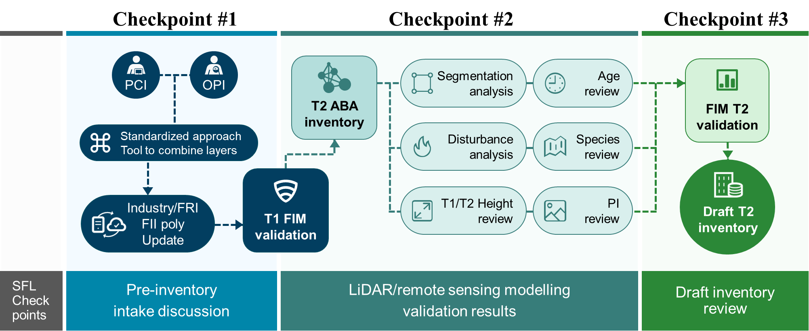



Function of the dashboards
Tableau Dashboard
Draft version 1.0
Used for internal review to identify uncommon values or potential issues in the Term 2 inventory data
Draft version 1.xxx
Few iterations between V1.0 and V2.0
Draft version 2.0
Shared with stakeholders to review all LiDAR metrics and compare results across FMUs and attributes
Final version
Used to deliver the finalized Term 2 interactive visualizations to the SFLs with direct links to the supporting dataset available through the FRI Partner Portal download
* All versions – accessible only by direct link
Notes:
The dashboards mainly support the checkpoint 3 stages, which is the delivery stage.
Early versions were used internally/semi-public to spot unusual values and data quality issues. Later versions supported stakeholder review across FMUs.
The final version is designed for delivery to industry and the public, so consistency and performance are critical.

Slide 5

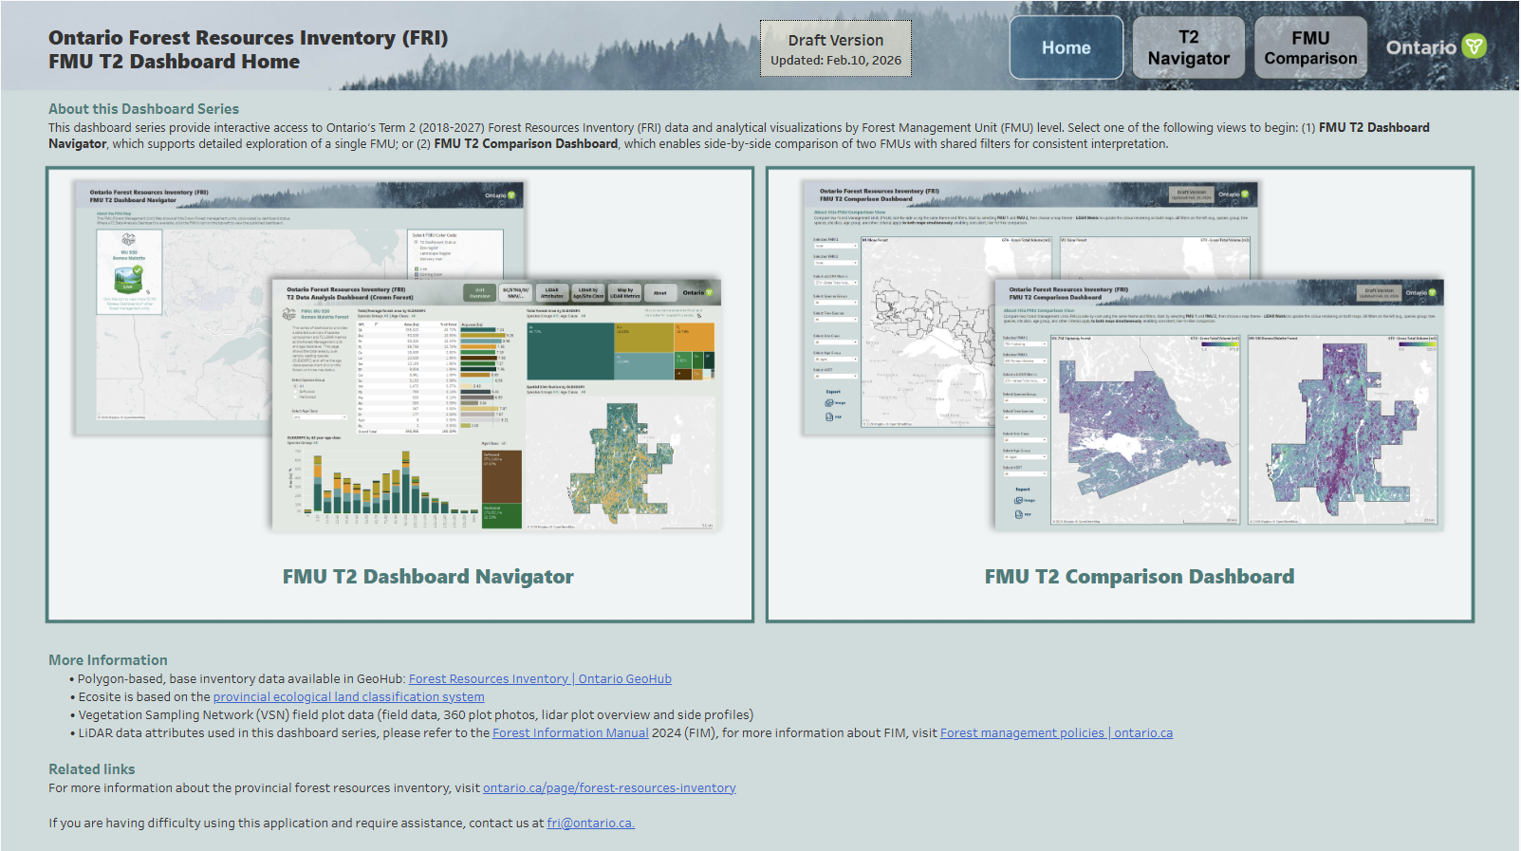
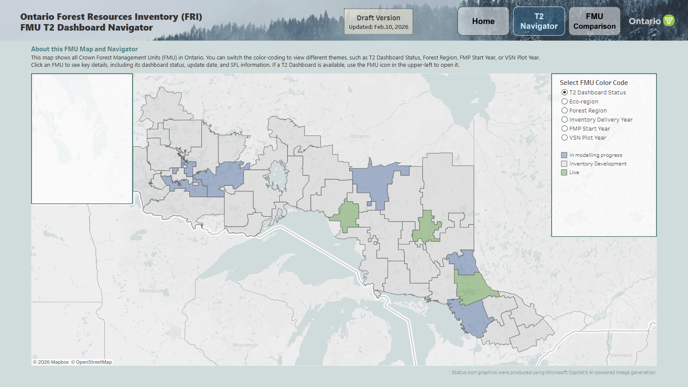
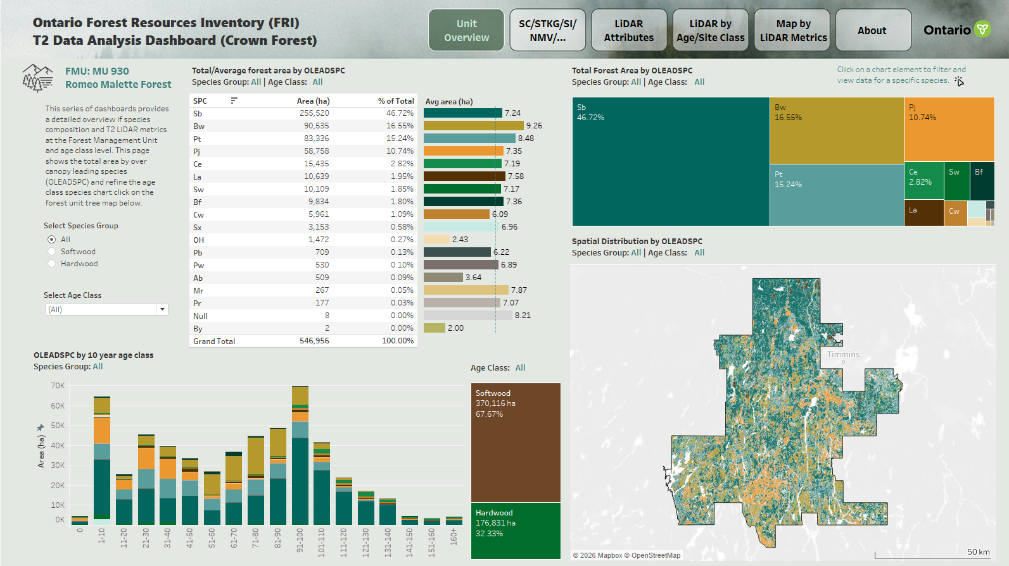
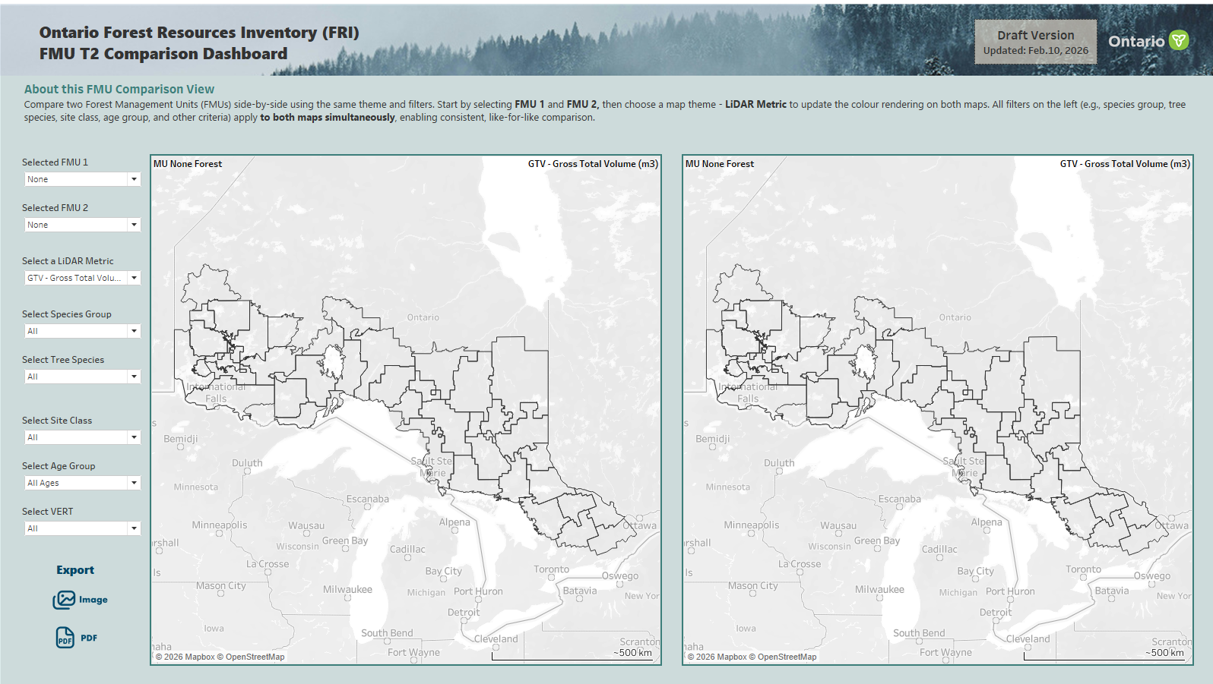
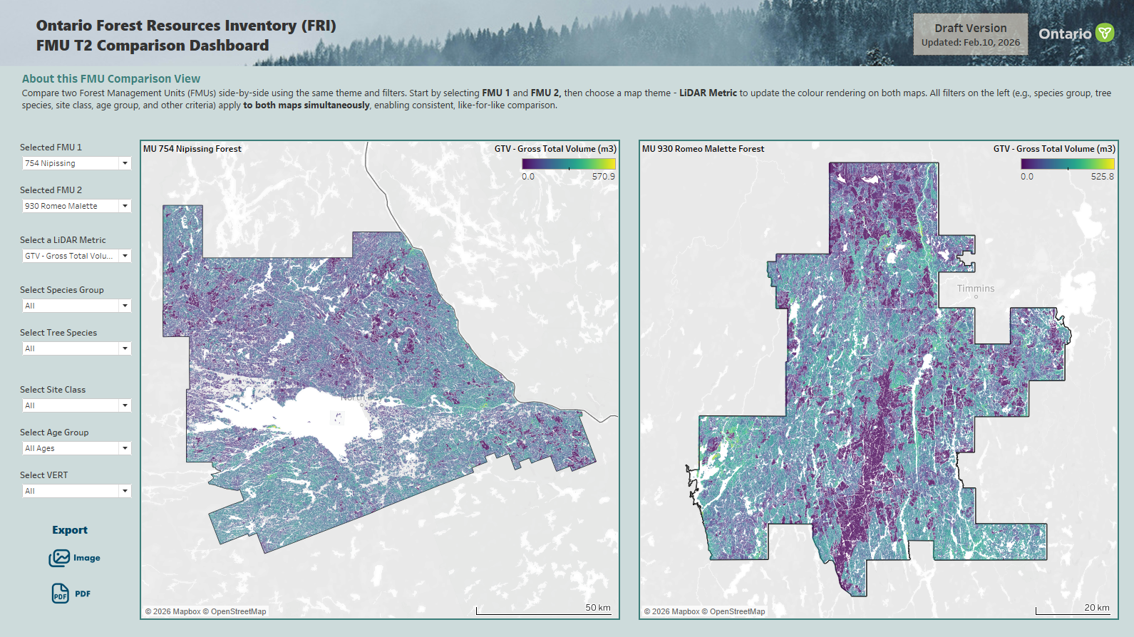
Dashboard overview
Two series of dashboards are planned to be published on Tableau Public as part of the FRI T2 (2018-2028) Delivery
0. Home page
1. FMU T2 Dashboard Navigator
1.1 FMU T2 Dashboard
FRI Dashboard Series include:
The FMU T2 Dashboards
The FMU T2 Comparison Dashboard
More products on the way (disturbance detail in development)
* FMU - Forest Management Unit
* FRI - Forest Resources Inventory
* T2 - Term 2 (2018-2028)
2. FMU T2 Comparison Dashboard
Notes:
We’re planning a series of dashboards on Tableau Public as part of the FRI T2 delivery.
This includes individual FMU dashboards and a comparison dashboard that allows users to compare LiDAR attributes across multiple FMUs.
More products, like disturbance details, are planned next.

Slide 6
Dashboard overview
Two series of dashboards are planned to be published on Tableau Public as part of the FRI T2 (2018-2027) Delivery
0. Home page
1. FMU T2 Dashboard Navigator
1.1 FMU T2 Dashboard
1. The FMU T2 Dashboards offer interactive products for exploring T2 inventory at the target FMU. They present spatial and statistical summaries of key LiDAR attributes, such as species, height, vertical structure, gross volumes, canopy closure, and so on…
2. The FMU T2 Comparison dashboard aggregates LiDAR attributes across all published FMUs, enabling industry vendors to compare forest conditions between forest units
2. FMU T2 Comparison Dashboard
Notes:
The FMU T2 dashboards allow users to explore forest conditions within a single unit.
The comparison dashboard aggregates results across all published FMUs, which is especially important for vendors and planners.
This requires handling large, multi‑FMU datasets efficiently.

Slide 7




New workflow with connection to Databricks
Convert format and data preparation
Raw geo-data update
Tableau visualization
MS Azure Storage
Tableau desktop
Tableau Public
  T2 shape files updates
  Excel tables updates:
    FMU planning schedule and dashboard status
    LiDAR Metadata table
    Species code/name table
  1. Shape files converted to PostgreSQL datasets with geometry function, can use SQL to do the calculations
  Connection using Databricks Lakebase Postgres server
  2. Excel tables converted to Delta tables
  Connection using the Databricks server
  Calculations can be done in Databricks using SQL
  Filters and parameters
  Dashboard design
  -------
  Connect with Databricks and PostgreSQL servers to grab all the datasets used within the dashboard
  Auto-refresh the data source each iteration of the workflow
  Using the connection with Databricks in Tableau Public
  Testing dashboard: delta connection test - FMU Navigator | Tableau Public
  (https://public.tableau.com/app/profile/ontariofri/viz/deltaconnectiontest-FMUNavigator/Db1)
Notes:
The new workflow moves data preparation into Databricks, which is a cloud‑based data platform. And because our raw data is located in Azure, so databricks can run smoothly with Azure.
Shapefiles and Excel tables are converted into database tables.
Tableau connects directly to these tables, and data can refresh automatically as updates happen.

Slide 8
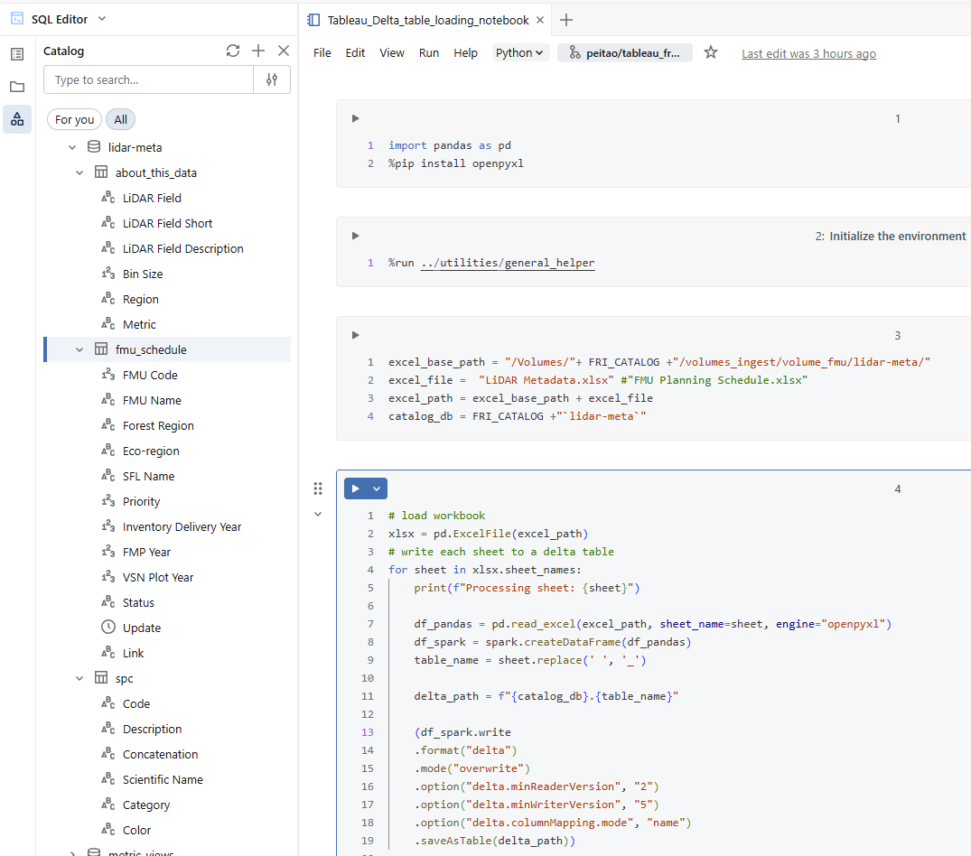
Data Transformation Scripts in Databricks
Excel‑to‑Delta Data
(table format)
Notes:
Spreadsheet‑based tables, like metadata and species lookups, are converted into Delta tables in Databricks.
This gives us a single, consistent source of truth that Tableau can always query.

Slide 9
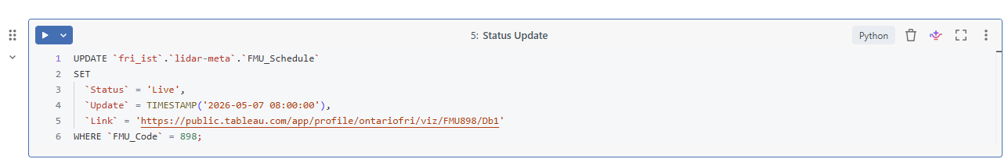
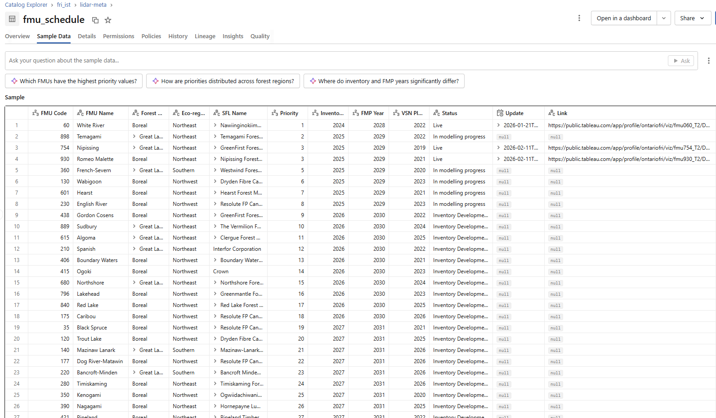
Data Transformation Scripts in Databricks
Excel‑to‑Delta Data
(table format)
Update FMU Status in Delta Table
Update the data behind the navigator map
Notes:
Updating FMU status or planning information now happens directly in Databricks.
Once the table is updated, the dashboard reflects the change without rebuilding extracts.

Slide 10
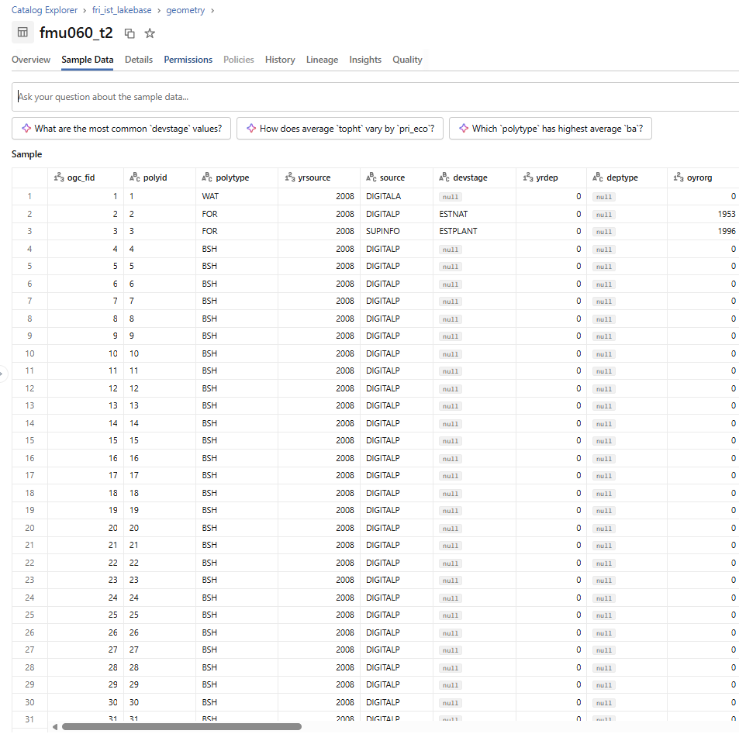
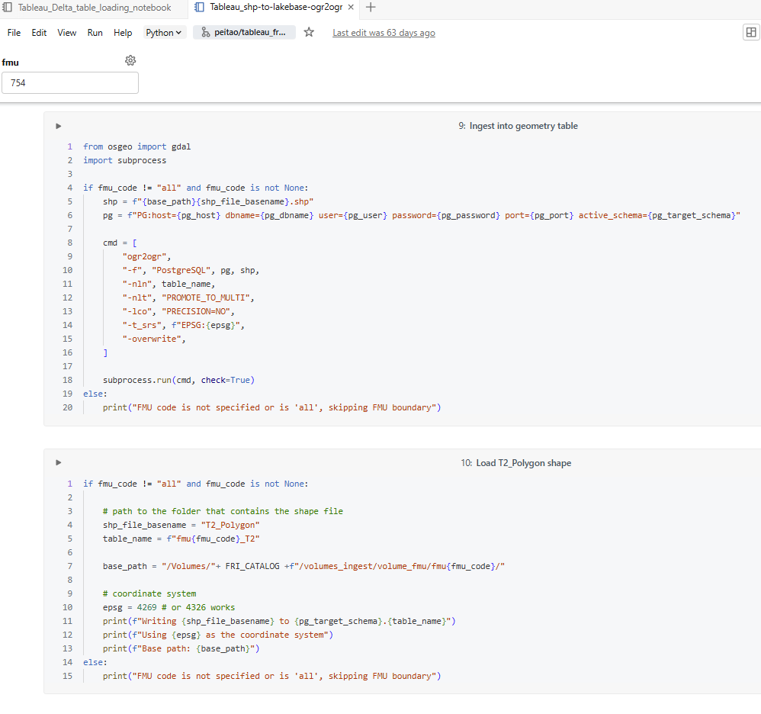
Data Transformation Scripts in Databricks
Shape file to Lakebase (geo-functional database)
Notes:
Spatial data is loaded into a PostgreSQL database with geospatial support.
This allows spatial calculations to run on the server instead of inside Tableau, which improves performance.

Slide 11
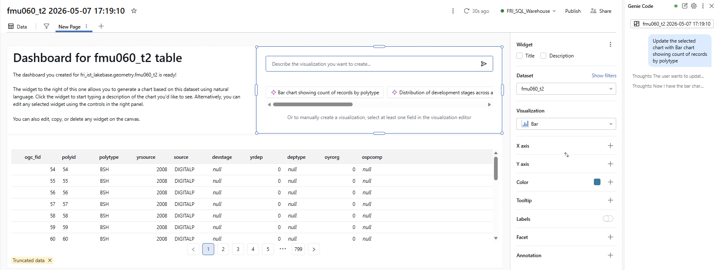
Data Transformation Scripts in Databricks
Quick Data Quality Assessment Using the Databricks AI Agent (Reference for the Final Product)
Relevant Data Preview
Quick Visualization Panel
AI Agent Interface
Notes:
Databricks also supports quick data quality checks.
We can preview data, run basic summaries, and catch issues earlier in the workflow before publishing dashboards.

Slide 12
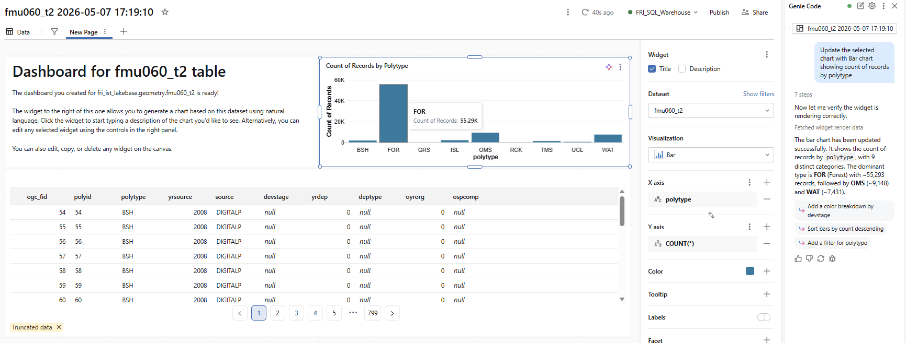
Data Transformation Scripts in Databricks
Quick Data Quality Assessment Using the Databricks AI Agent (Reference for the Final Product)
Relevant Data Preview
Quick Visualization Panel
AI Agent Interface
Notes:
This step helps ensure that what we publish externally is consistent and trustworthy.
It reduces rework later and supports confidence in the final products.

Slide 13
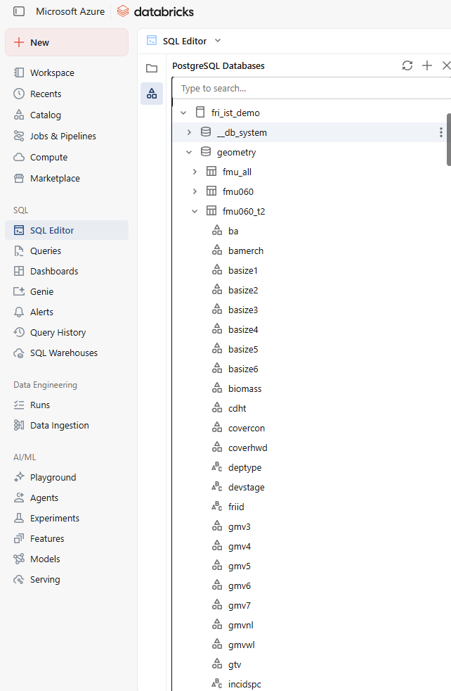
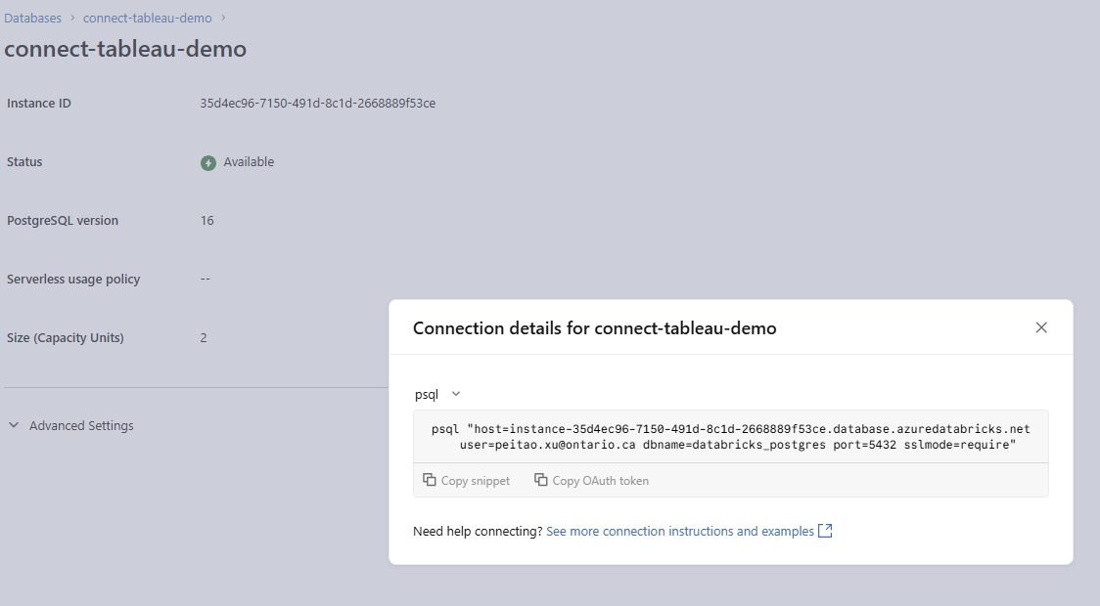
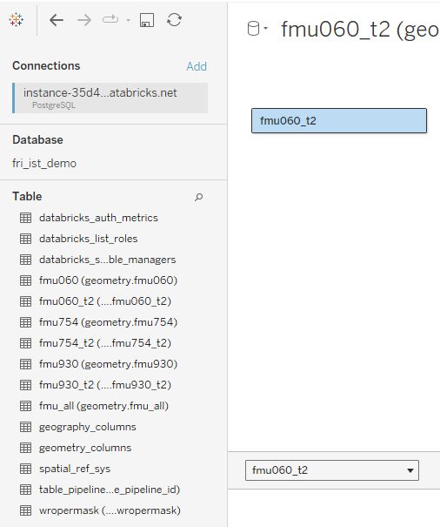
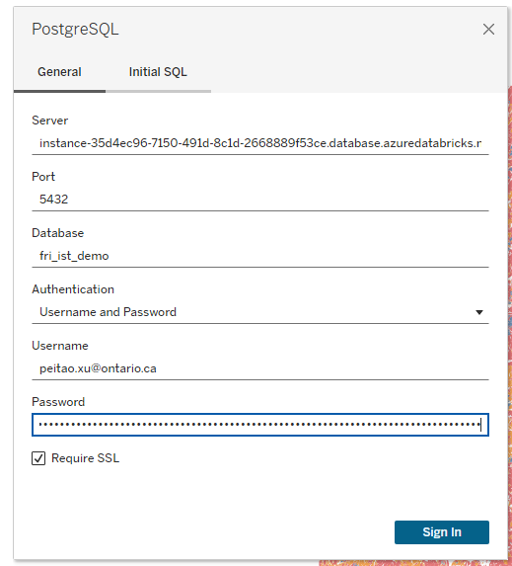
Databricks server to Tableau connection
Postgres Lakebase servers and connection
Tableau retrieve data
from PostgreSQL database
1. Shape files to PostgreSQL Database
Notes:
Tableau connects to the PostgreSQL database to retrieve spatial datasets.
Tableau focuses on visualization, while the database handles storage and heavy processing.

Slide 14

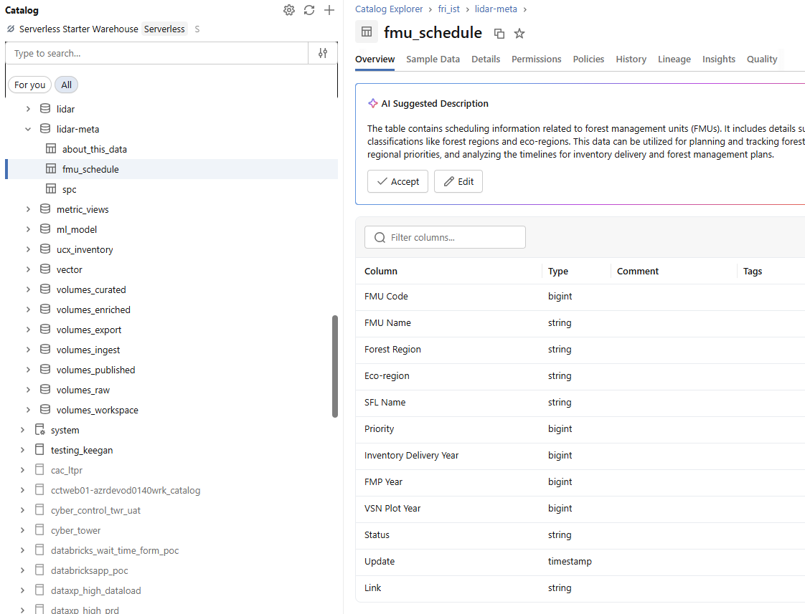
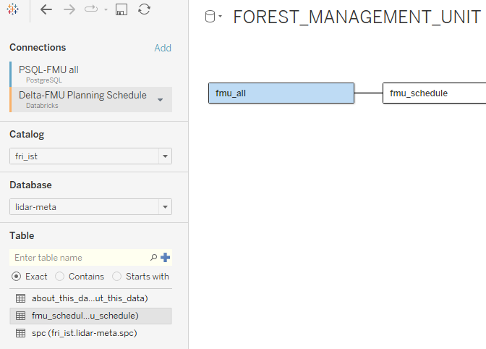
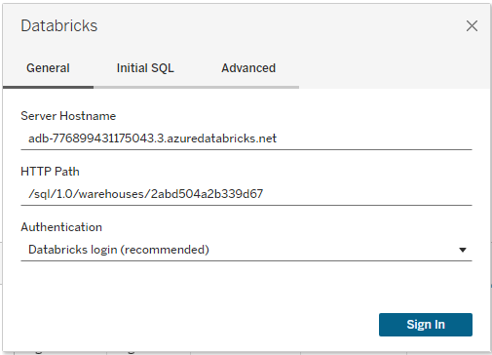
Databricks server to Tableau connection
2. Excel Spreadsheet to Delta Table
Tableau retrieve data
from Databricks database
Databricks
server
Notes:
For non‑spatial tables, Tableau connects directly to Databricks.
From a Tableau user perspective, this feels like connecting to any other database.

Slide 15
New workflow with connection to Databricks
Pros:
  Streamlined updates - updating data in Databricks can automatically refresh dashboards; no need to rebuild extracts
  Calculations and updates can be done in Databricks using SQL
  Good for large‑scale or multi‑FMU development
  Better collaboration using the same path in Azure, instead of the path in the local drivers
  Future LiDAR updates (disturbance, etc.) might be more supported using Databricks
Potential Limitation:
  Initial setup effort - requires loading shapefiles and spreadsheets into Databricks/PostgreSQL
Other consideration:
  Version control challenges? How to save both the old version and the latest version of the data there
Notes:
The main benefits are streamlined updates, better performance for large datasets, and easier collaboration.
The main trade‑off is initial setup effort.
Overall, this approach is more sustainable as data volume and dashboard use continue to grow.

Slide 16
Forest Resources Inventory
Tableau Dashboard with Databricks Tables as cloud‑based data source
Thanks!
May 08, 2026
Notes:
In summary, using Databricks as a cloud‑based data source allows us to deliver more reliable, scalable products with Tableau.

